Slide 1
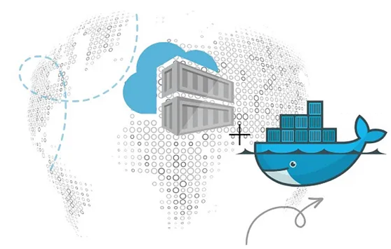
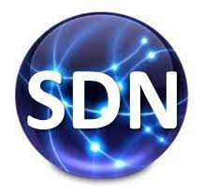
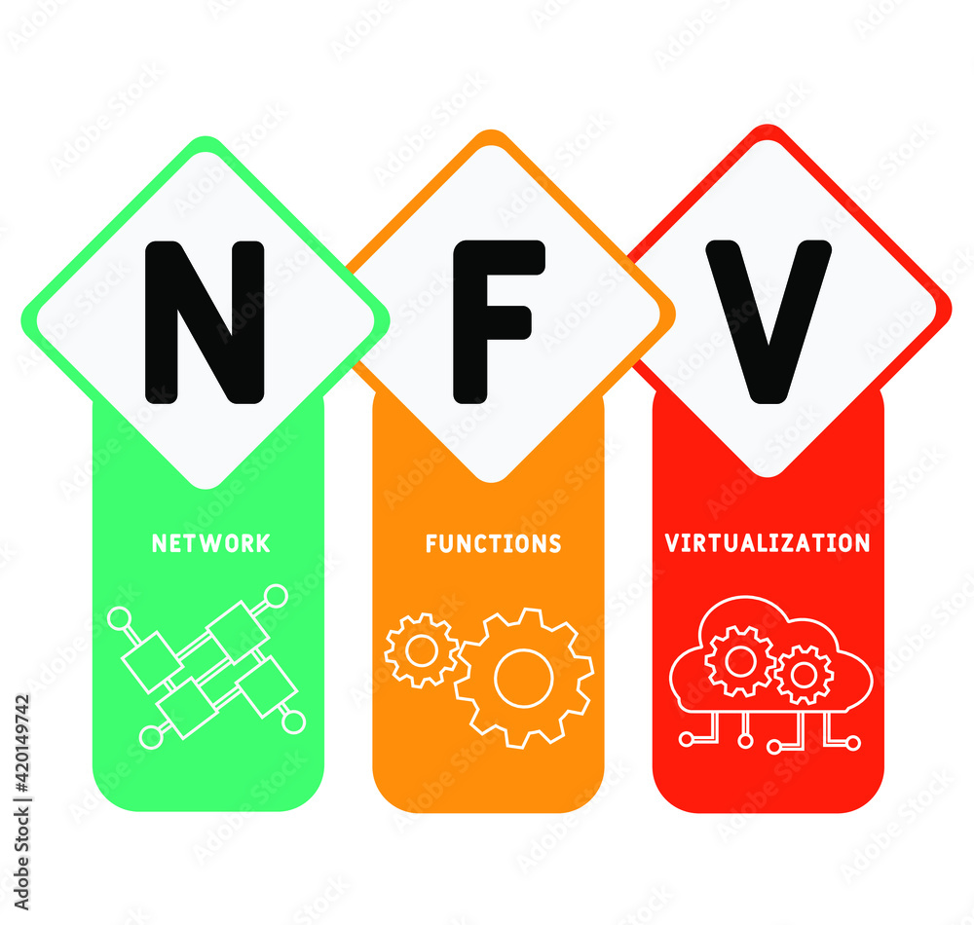
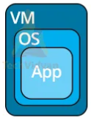
PDS
Computer Vision
Chapter 2
IoT Ecosystem
Part 1-1
https://github.com/siagianp
https://www.youtube.com/@AmelOline/videos
https://github.com/amelcharolinesgn2/IoT_simulator-mqtt-NodeRed
https://github.com/amelcharolinesgn2/Cloud-Infrastructures
https://github.com/amelcharolinesgn2/IoT_app-and-Modules
https://github.com/amelcharolinesgn2/ClouD-Infrastructure-SISKA-2025
Notes:
https://www.mi.fu-berlin.de/inf/groups/ag-tech/teaching/2012-13_WS/L_19528_Embedded_Internet_and_the_Internet_of_Things/08.pdf
https://www.hivemq.com/blog/mqtt-vs-coap-for-iot/

Slide 2
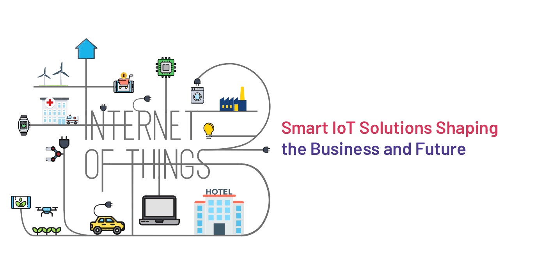
IoT Deployment Challenges
Notes:
https://medium.com/tech-vibes/common-iot-deployment-challenges-and-how-to-overcome-them-fd62e59497d0

Slide 3
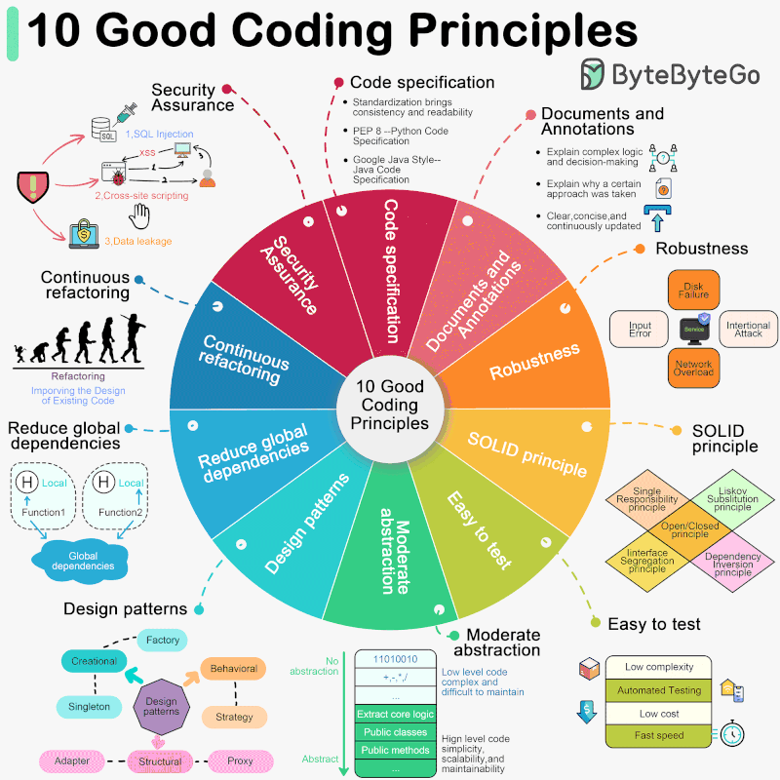
Notes:
https://blog.bytebytego.com/p/ep97-10-good-coding-principles-to

Slide 4
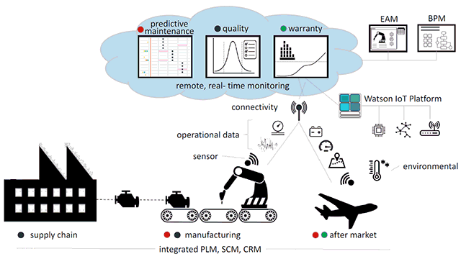
IoT Deployment Challenges
Notes:
https://medium.com/altoros-blog/boeing-improves-operations-with-blockchain-and-the-internet-of-things-6ceb4db283a7

Slide 5
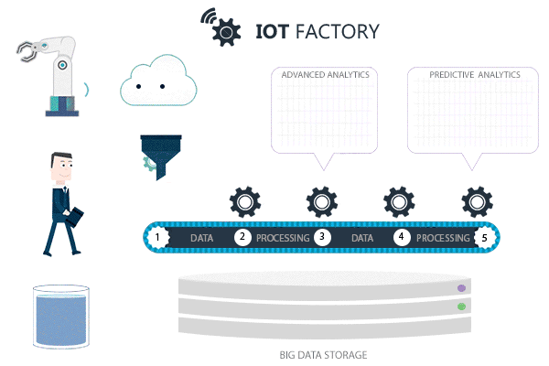
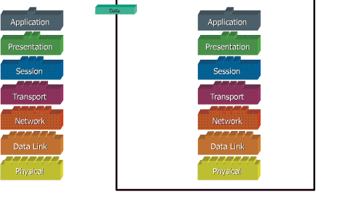
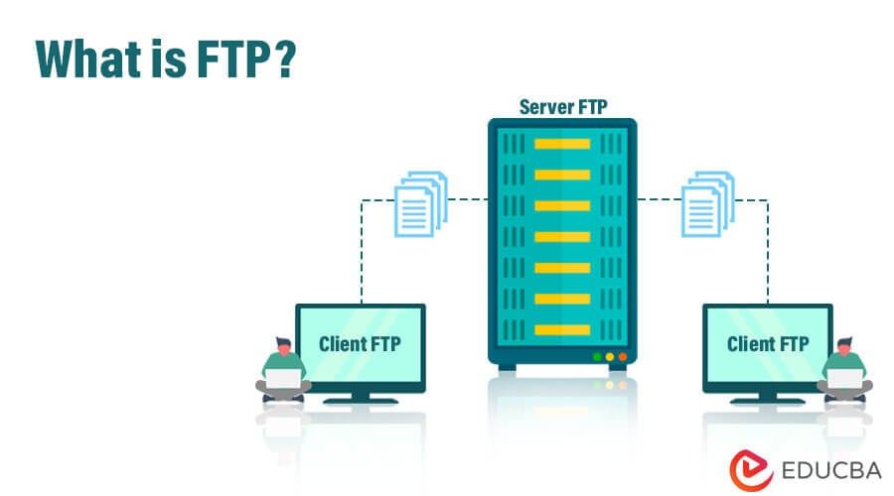
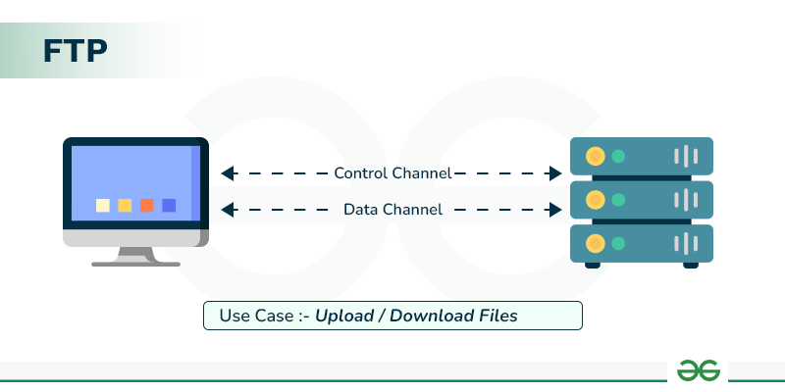
IoT ecosystem
Purposed : Application for IoT devices and data transmissions
Send & Received
IoT ecosystem
The IoT Ecosystem-Components: Sensor Device, Architecture, Communication Technologies, and Protocols
Notes:
https://www.krasamo.com/machine-learning-in-iot/
file:///D:/Matakuliah%202024/IoT/IoT_T/Week%208%20-%20Module%2019%20-%20PPT-%20Internet%20of%20Things%20for%20Libraries.pdf
FTP Server Working and its Benefits - GeeksforGeeks
Machine Learning in IoT: Advancements and Applications | Krasamo

Slide 6
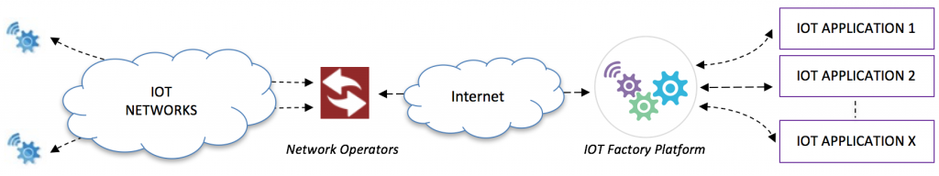
IoT ecosystem
Notes:
https://iotfactory.eu/iot-software-platform/

Slide 7
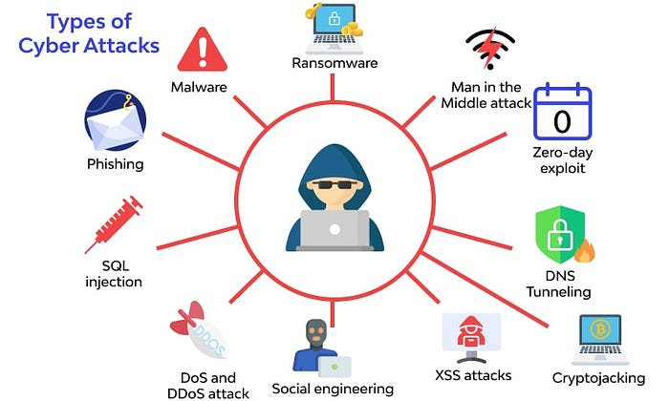
IoT ecosystem
The IoT Ecosystem- Components: Sensor Device, Architecture, Communication Technologies, and Protocols
Figure. Ecosystem IoT
Applications
Management
(Process, Analysis, Monitoring)
Security & Privacy
Programming Model, Evaluated
Communication & Protocols
Sensing & Components
Notes:
https://www.researchgate.net/publication/364331685_The_IoT_Ecosystem_Components_Architecture_Communication_Technologies_and_Protocols
https://medium.com/tech-vibes/common-iot-deployment-challenges-and-how-to-overcome-them-fd62e59497d0
https://library.iitd.ac.in/arpit_2020-2021/Week%208%20-%20Module%2019%20-%20PPT-%20Internet%20of%20Things%20for%20Libraries.pdf

Slide 8
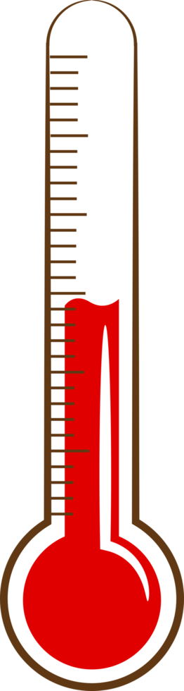
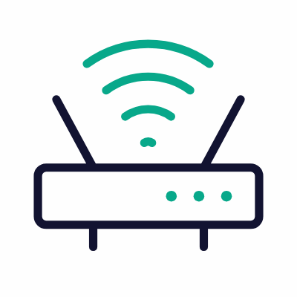


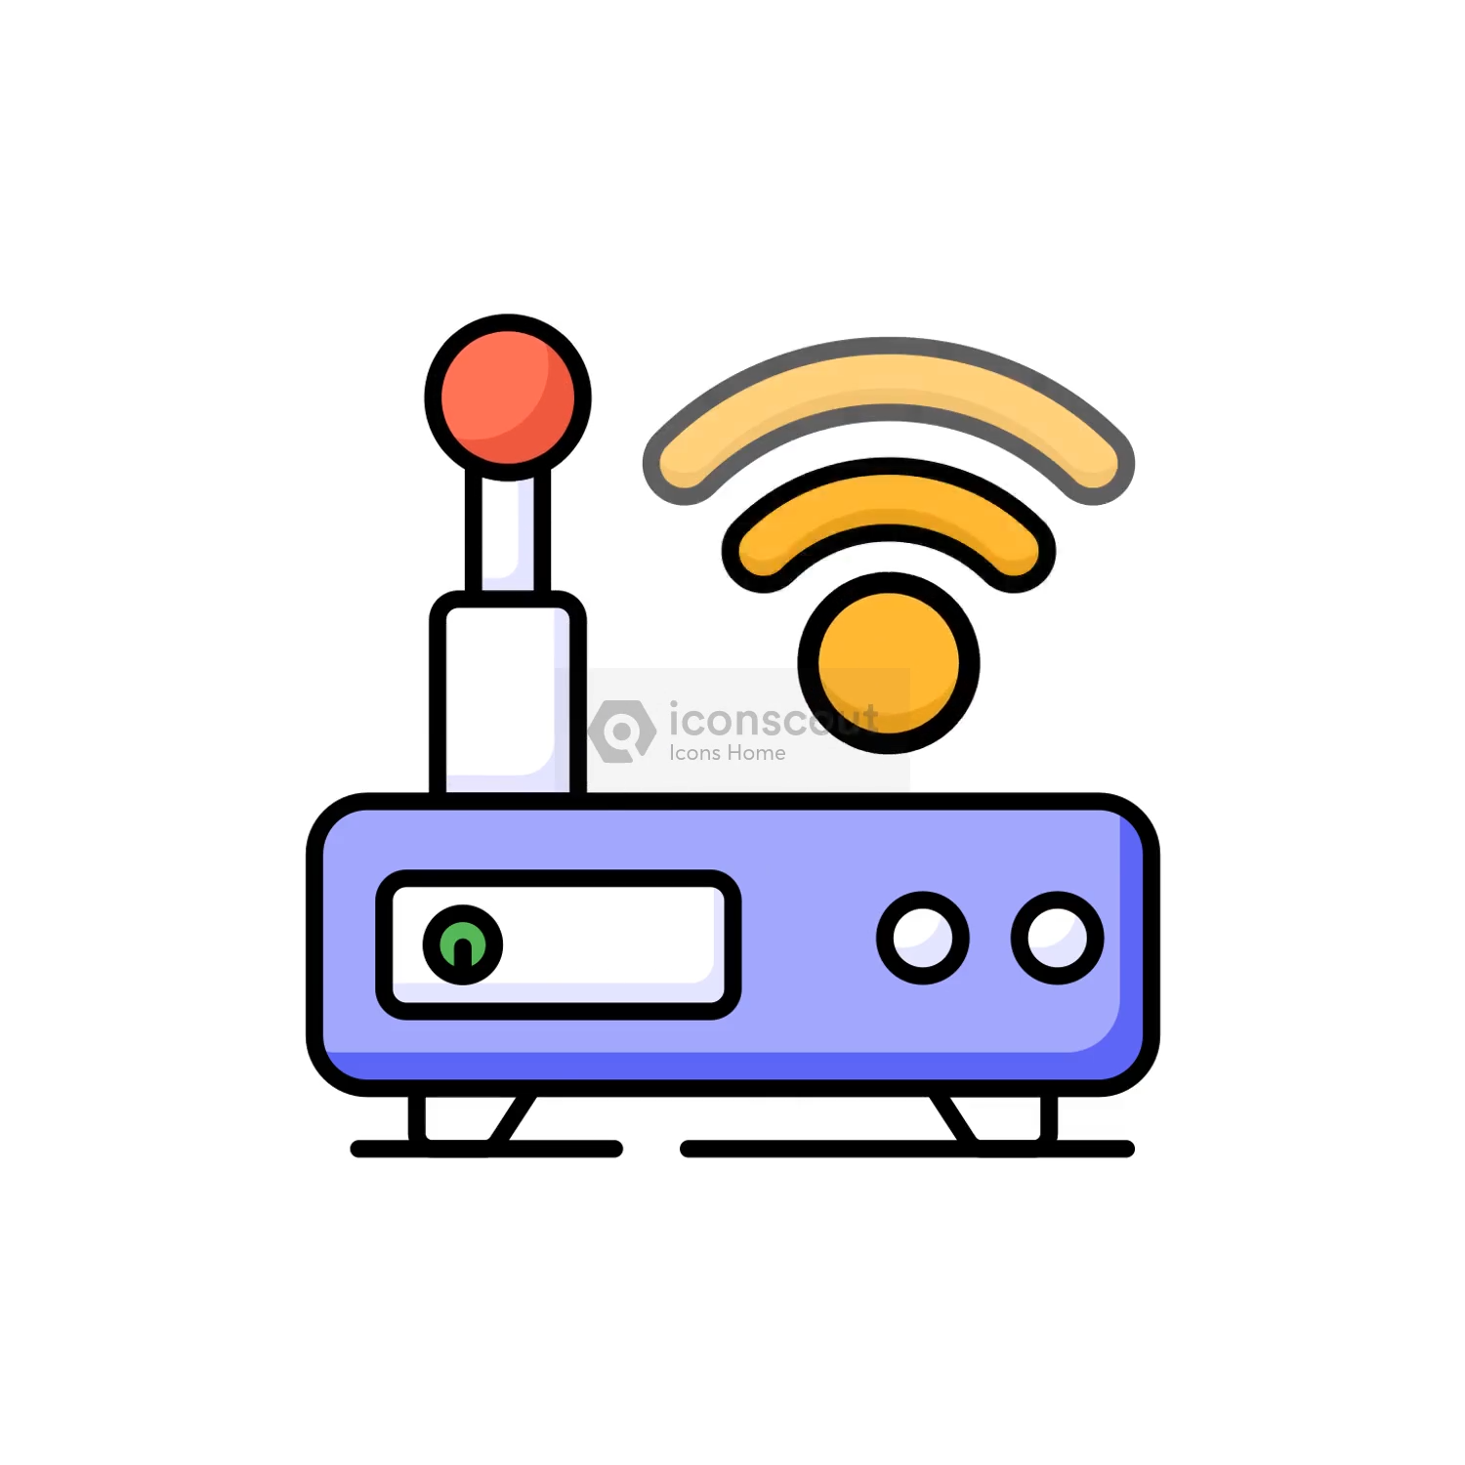
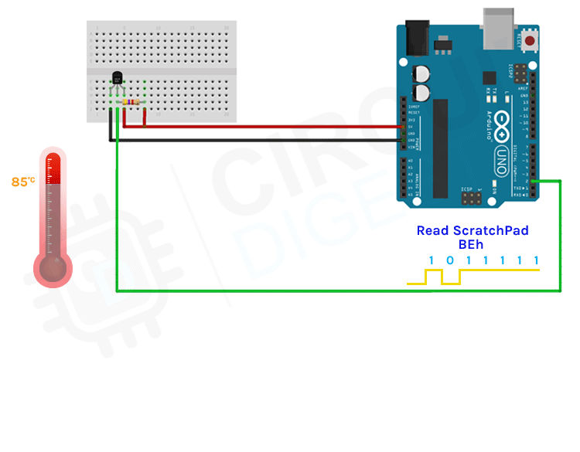
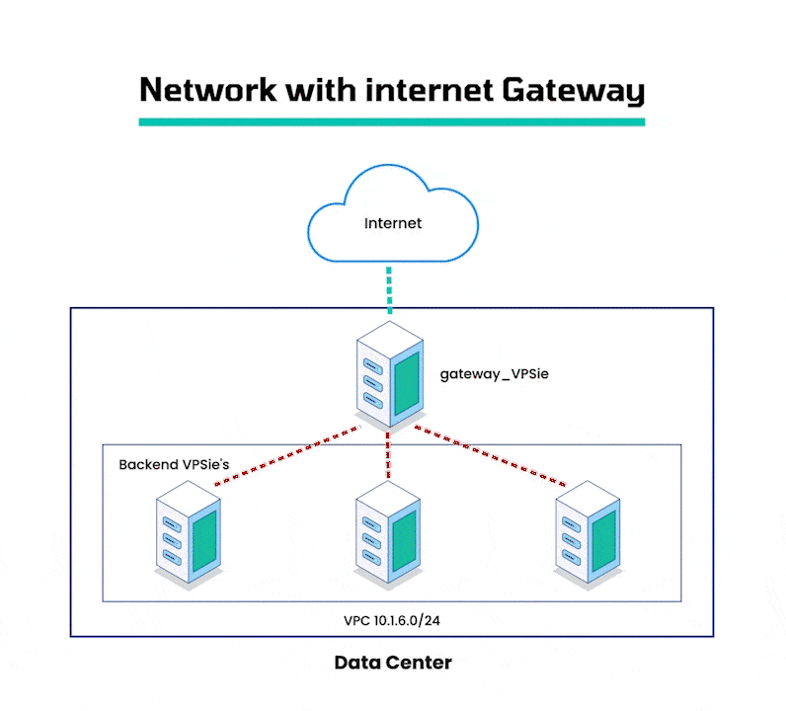
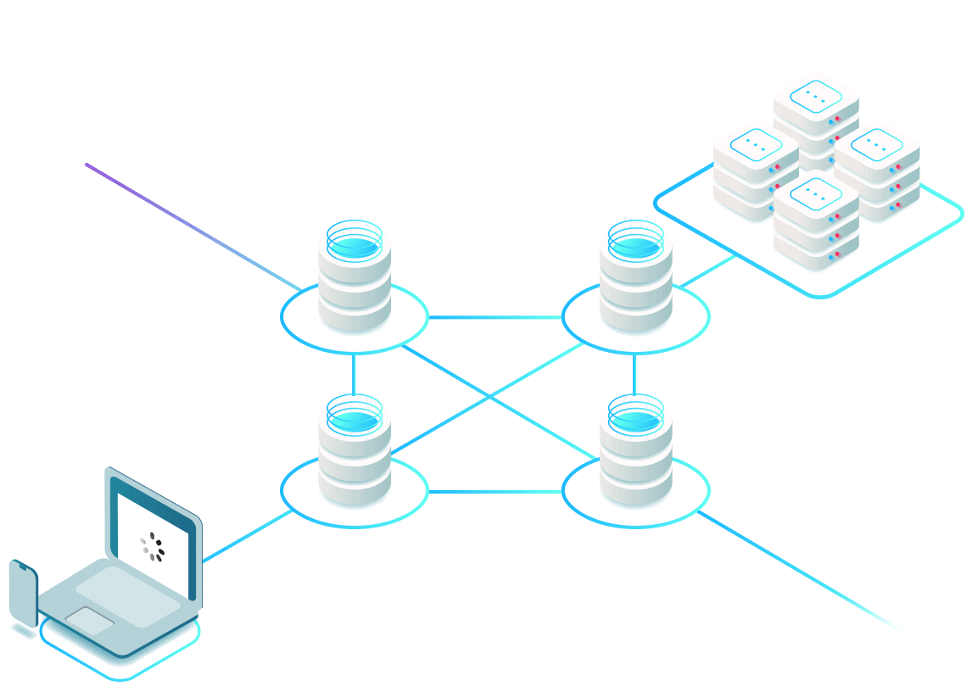

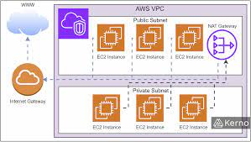
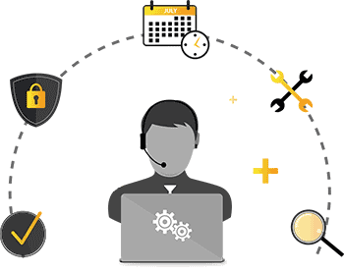
Components Of IoT Things IOT
IoT ecosystem
1
2
3
4
5
Cloud, Storage, Management Services
IoT Device
(Sensor,+ MC)
Network Device
(Gateway, Network)
Protocols
(OSI Model)
Application layer
Process, Analysis, Monitoring
1
6
Security & Privacy
Notes:
Components of iot architecture internet of things iot
https://www.mongodb.com/resources/basics/cloud-explained/iot-architecture

Slide 9
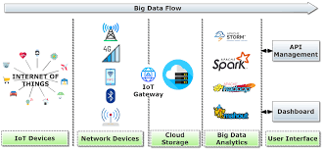
Example 1IOT
IoT ecosystem
Notes:
https://onlinelibrary-wiley-com.translate.goog/doi/abs/10.1002/ett.4618?_x_tr_sl=en&_x_tr_tl=id&_x_tr_hl=id&_x_tr_pto=imgs

Slide 10
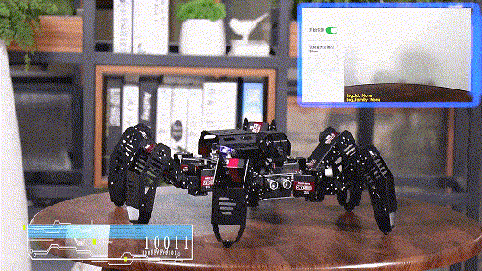
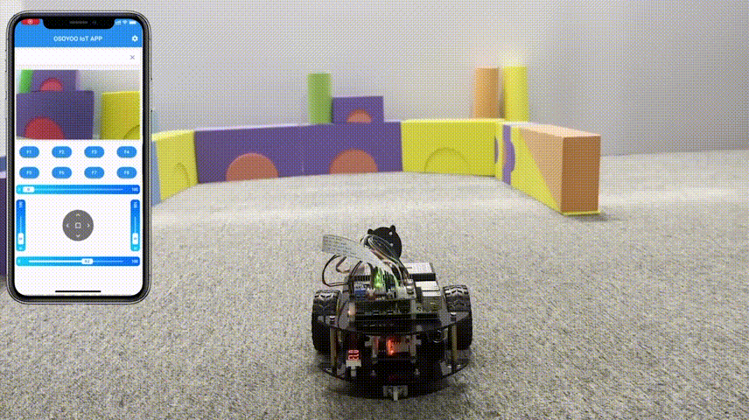
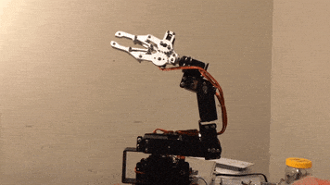
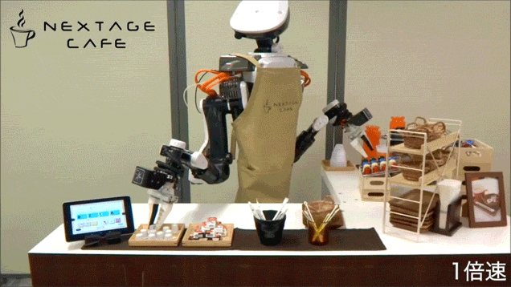
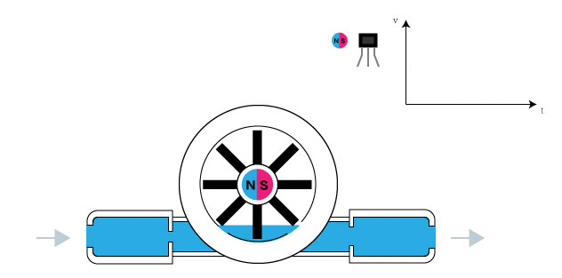
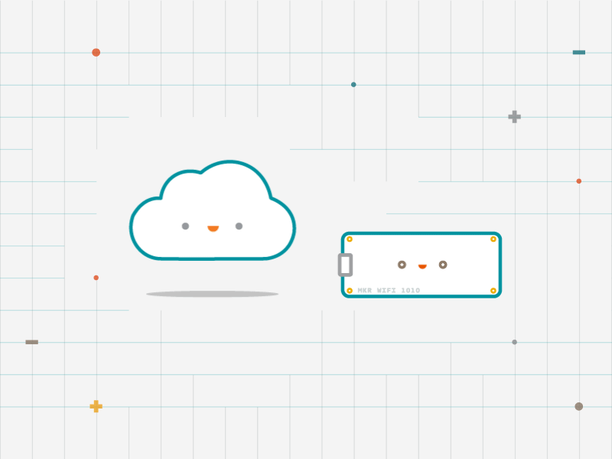
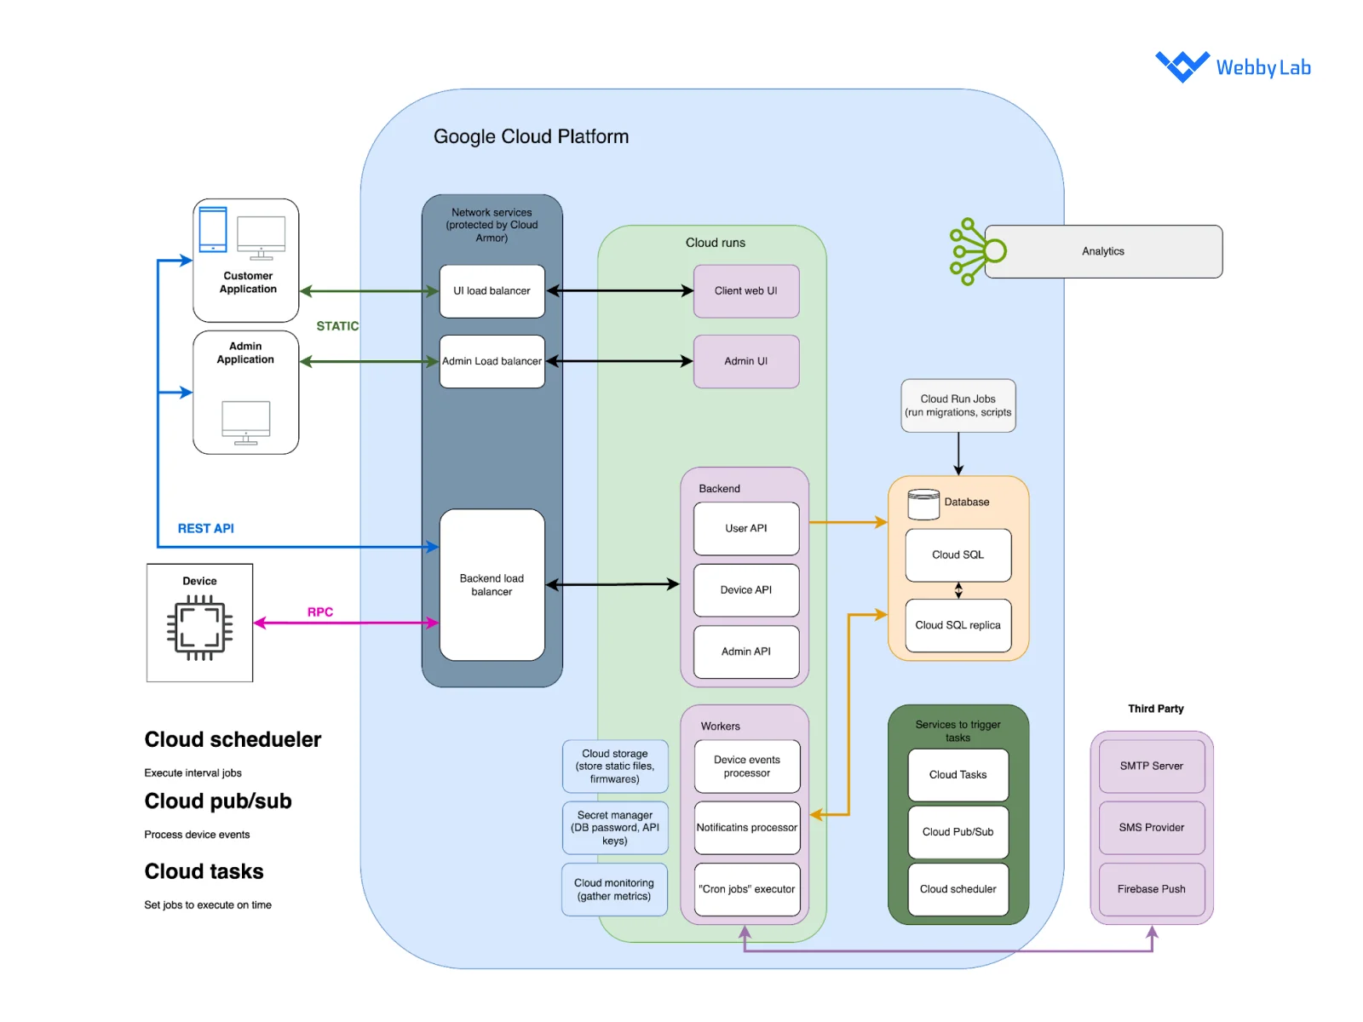
Sensor Device Of IoT
1
Transmit Data
Notes:
https://www.engineegroup.us/articles/ARA-6-115.php
https://webbylab.com/blog/iot-architecture/
https://cloud.google.com/architecture/connected-devices/iot-platform-product-architecture?hl=id

Slide 11
Sensor Device Of IoT
1
Transmit Data
Notes:
https://www.engineegroup.us/articles/ARA-6-115.php
https://webbylab.com/blog/iot-architecture/
https://cloud.google.com/architecture/connected-devices/iot-platform-product-architecture?hl=id

Slide 12
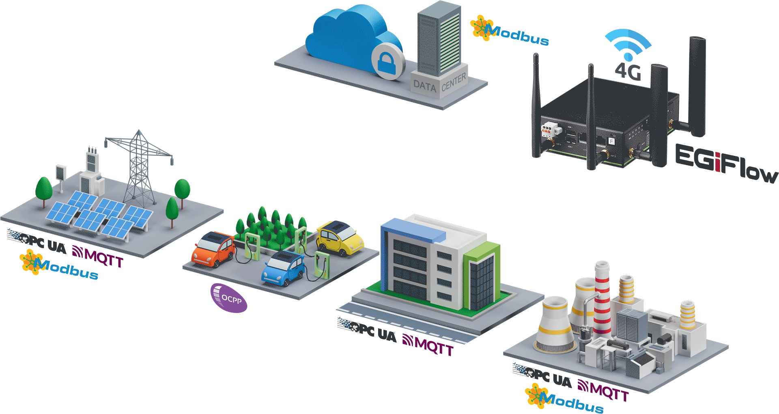
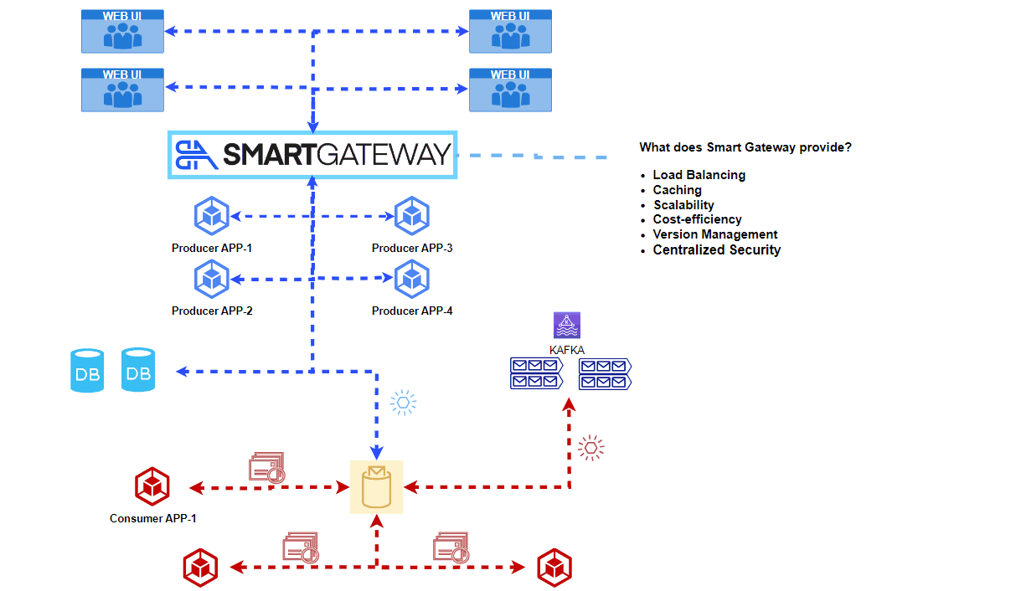
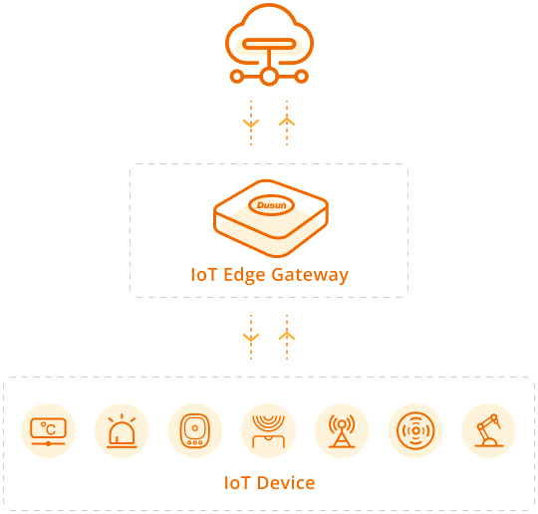
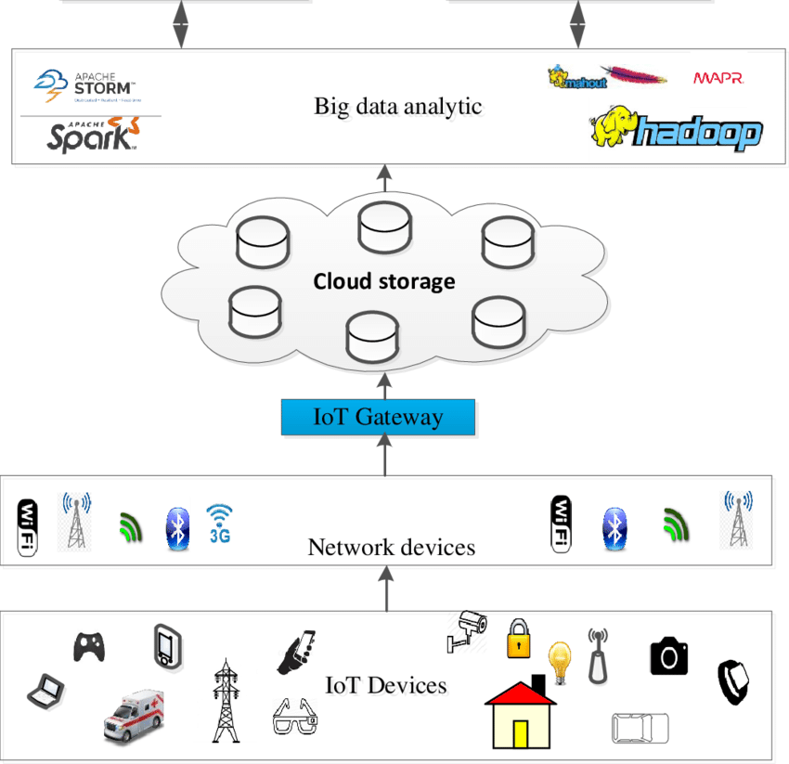
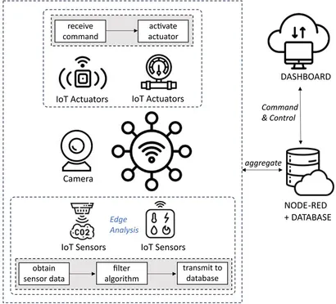
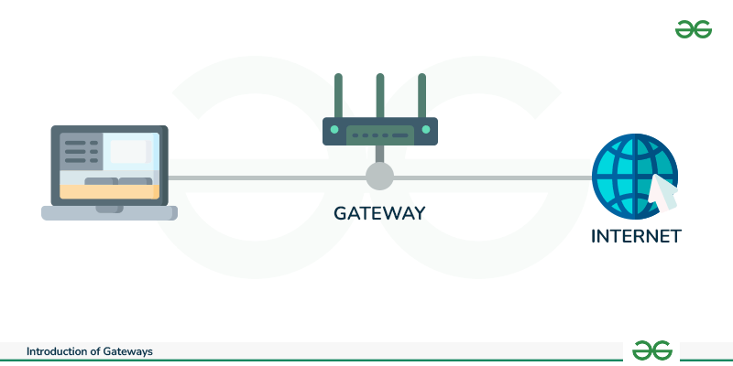
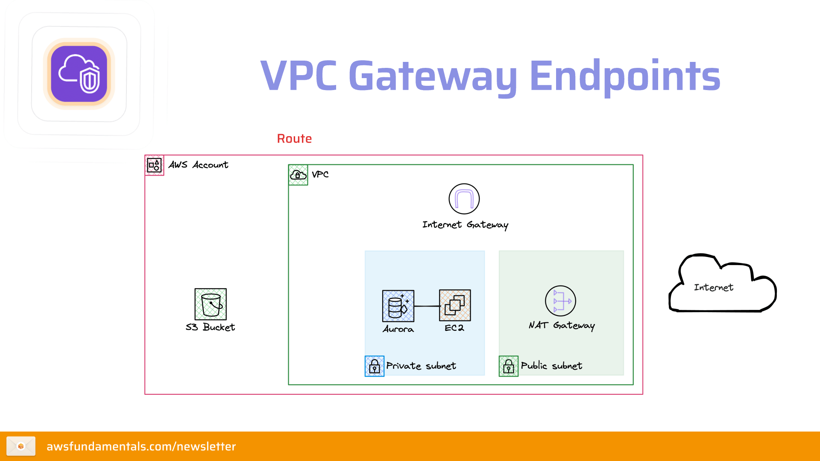
Gateway & Network Of IoT
Smart gateway:
2
IoT Gateway
Notes:
https://www.adlinktech.com/fr/industrial-iot-gateway
https://www.google.com/imgres?q=architecture%20for%20IoT%20gif&imgurl=https%3A%2F%2Fcdn-source.adlinktech.com%2FWebUpd%2Fen%2FUpload%2FIndustrial_IoT_gateway%2FIIoT_Gateway_Second_v3.gif&imgrefurl=https%3A%2F%2Fwww.adlinktech.com%2Ffr%2Findustrial-iot-gateway&docid=lGNnMpNsrOLN3M&tbnid=BBY6oeYzBZbcEM&vet=12ahUKEwjh6dulioWQAxXJzTgGHfKkLFgQM3oECBwQAA..i&w=1920&h=1020&hcb=2&ved=2ahUKEwjh6dulioWQAxXJzTgGHfKkLFgQM3oECBwQAA
https://medium.com/@digvijay17july/how-smart-gateway-by-b2alabsaids-event-driven-architecture-in-microservices-fba4dc91eee9
https://www.frontiersin.org/journals/the-internet-of-things/articles/10.3389/friot.2023.1256163/full
https://www.dusuniot.com/blog/what-is-iot-edge-computing-gateway/

Slide 13
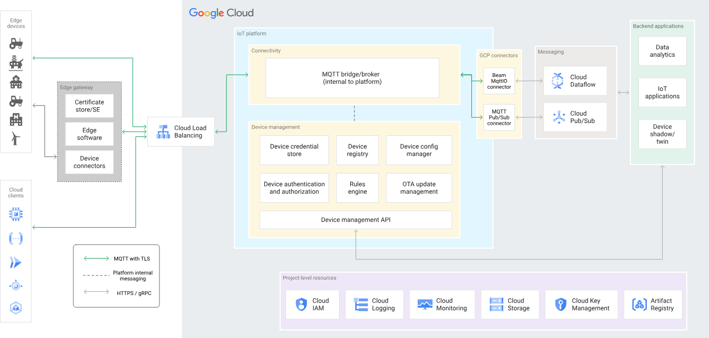
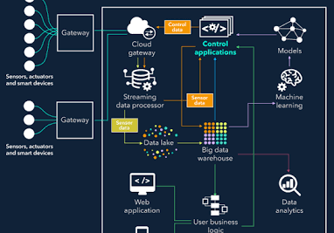
Architecture Of IoT
3
Notes:
https://webbylab.com/blog/iot-architecture/
https://cloud.google.com/architecture/connected-devices/iot-platform-product-architecture?hl=id

Slide 14
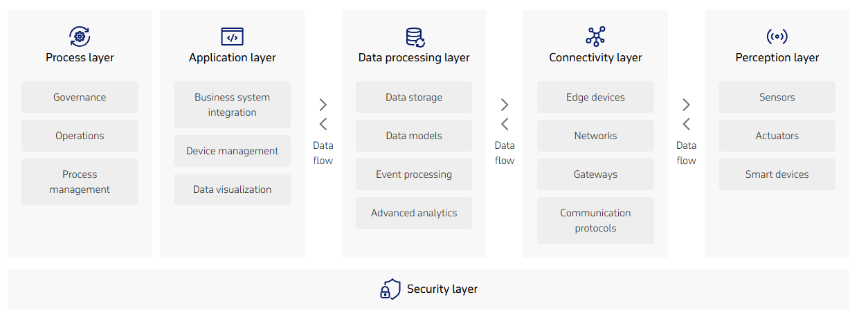
Architecture Of IoT (Cont’s)
Notes:
https://www.itransition.com/iot/architecture

Slide 15
Architecture Of IoT (Cont’s)
Architecture of IoT
Data processing Layer: The data processing layer of IoT architecture refers to the software and hardware components that are responsible for collecting, analyzing, and interpreting data from IoT devices. This layer is responsible for receiving raw data from the devices, processing it, and making it available for further analysis or action. The data processing layer includes a variety of technologies and tools, such as data management systems, analytics platforms, and machine learning algorithms. These tools are used to extract meaningful insights from the data and make decisions based on that data. Example of a technology used in the data processing layer is a data lake, which is a centralized repository for storing raw data from IoT devices.
Application Layer: The application layer of IoT architecture is the topmost layer that interacts directly with the end-user. It is responsible for providing user-friendly interfaces and functionalities that enable users to access and control IoT devices. This layer includes various software and applications such as mobile apps, web portals, and other user interfaces that are designed to interact with the underlying IoT infrastructure. It also includes middleware services that allow different IoT devices and systems to communicate and share data seamlessly. The application layer also includes analytics and processing capabilities that allow data to be analyzed and transformed into meaningful insights. This can include machine learning algorithms, data visualization tools, and other advanced analytics capabilities.
The architecture of IoT is divided into 4 different layers i.e. Sensing Layer, Network Layer, Data processing Layer, and Application Layer.
Sensing Layer: The sensing layer is the first layer of the Internet of Things architecture and is responsible for collecting data from different sources. This layer includes sensors and actuators that are placed in the environment to gather information about temperature, humidity, light, sound, and other physical parameters. Wired or wireless communication protocols connect these devices to the network layer.
Network Layer: The network layer of an IoT architecture is responsible for providing communication and connectivity between devices in the IoT system. It includes protocols and technologies that enable devices to connect and communicate with each other and with the wider internet. Examples of network technologies that are commonly used in IoT include WiFi, Bluetooth, Zigbee, and cellular networks such as 4G and 5G technology. Additionally, the network layer may include gateways and routers that act as intermediaries between devices and the wider internet, and may also include security features such as encryption and authentication to protect against unauthorized access.
Notes:
https://www.geeksforgeeks.org/computer-networks/architecture-of-internet-of-things-iot/

Slide 16
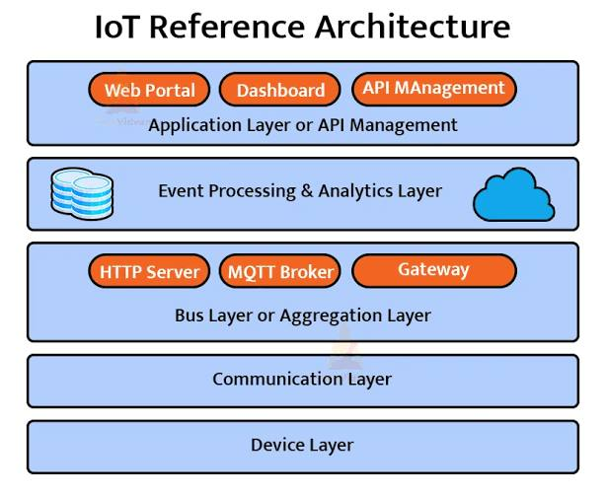
Architecture Of IoT (Cont’s)
Notes:
https://www.geeksforgeeks.org/computer-networks/architecture-of-internet-of-things-iot/

Slide 17
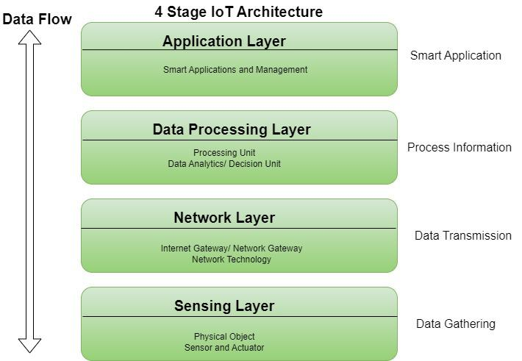
Architecture Of IoT (Cont’s)Of Things IOT

Slide 18
Architecture Of IoT (Cont’s)Of Things IOT
Advantages of IoTOf Things IOT
Execute multiple tasks at a time like a computer.
Easiest internet connectivity
Works on GUI (Graphical User Interface) mode because of HDMI port.
Best suited for server-based applications i.e., can be connected via SSH–Secure Shell-to access the Rpi command line remotely and file sharing via FTP–File Transfer Protocol.
More reliable for software applications.

Slide 19
Architecture Of IoT (Cont’s)Of Things IOT
Disadvantages of IoTf Things IOT
Security concerns and potential for hacking or data breaches.
Privacy issues related to the collection and use of personal data.
Dependence on technology and potential for system failures.
Limited standardization and interoperability among devices.
Complexity and increased maintenance requirements.
High initial investment costs.
Limited battery life on some devices.
Concerns about job displacement due to automation.
Limited regulation and legal framework for IoT, which can lead to confusion and uncertainty.

Slide 20
Architecture Of IoT (Cont’s)Of Things IOT
Modern Applications of IoT
Things IOT
Smart Grids and energy saving
Smart cities
Smart homes/Home automation
Healthcare
Earthquake detection
Radiation detection/hazardous gas detection
Smartphone detection
Water flow monitoring
Traffic monitoring
Smart door lock protection system
Robots and Drones
Healthcare and Hospitals, Telemedicine applications
Biochip Transponders (For animals in farms)

Slide 21
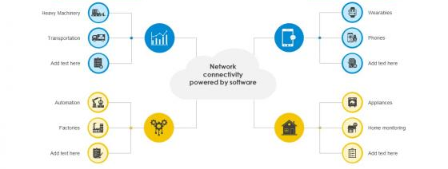
Communication
4
Communication Technology Of IoT
IoT Enabled Network Connectivity
Industrial IoT
Computer

Slide 22
Thank you!
PDS
Computer Vision
Next >>> Chap2_IoT Ecosystem_Part1-2.pptx
Q&A
Thank you For being a great class!
https://github.com/siagianp
https://www.youtube.com/@AmelOline/videos
https://github.com/amelcharolinesgn2/IoT_simulator-mqtt-NodeRed
https://github.com/amelcharolinesgn2/Cloud-Infrastructures
https://github.com/amelcharolinesgn2/ClouD-Infrastructure-SISKA-2025
Notes:
https://medium.com/buildpiper/simplifying-containerization-with-docker-run-command-2f74e114f42a
https://github.com/IBA-Group-IT/IoT-data-simulator
https://www.bevywise.com/blog/docker-mqtt-broker-easy-service-manageability/

